Slide 1
Reginald Kenneth Dwight Aka: Sir Elton John
By: Hannah Richins

Slide 2
Elton John
Born: March 25, 1947
Still alive at age 70
300 million records
Notes:
Elton John was born on March 25, 1947 in Pinner United Kingdom. In his five-decade career he has sold more than 300 million records which have included “Goodbye Yellow Brick Road”(Released in 1973, and still a huge hit) “Madman Across the Water”, and “Tumbleweed Connection”

Slide 3
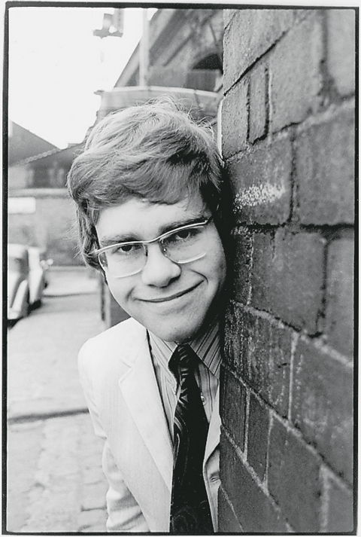
Biography
The oldest of four children
Piano at age three
Royal Academy of Music
Pub Pianist in 1962
Notes:
Elton was the oldest of four children whose parents were Stanley Dwight and Sheila Eileen. He started playing the piano at three years old. He showed natural music aptitude at school which won him a scholarship to the Royal Academy of Music, and studied there for five years. His mother helped get him gigs at local pubs.

Slide 4
Biography
“Bluesology”
In 1967, Bernie Taupin partnership began
Session musician for artists
Notes:
Elton spent his nights playing solo gigs and also working with Bluesology. By the 1960s Bluesology was touring with bands like, “The Isley Brothers” and “Patti Labelle and the Bluebelles.” In 1967 Elton interviewed with a British magazine, “New Musical Express” and then for “Liberty Records”. At the meeting he was handed a stack of lyrics written by Bernie Tauplin. He wrote the music for him and that’s when their partnership started.

Slide 5
Biography
Released many number one hits
“You’re Song”
“Tiny Dancer”
“Goodbye Yellow Brick Road”
“Rocket Man”
Notes:
Between 1969-1973 Elton John and Bernie Tauplin started writing more complex songs. The first record hit was “Border Song”, released in 1970. Other popular songs that were sung by Elton John include, “Daniel”(1973), “Don’t Go Breaking My Heart”(co-sung with Kiki Dee), “Crocodile Rock”(1972), “Don’t let the sun go down on me”(1974), “Candle in the Wind”(1973), “Honky Cat”(1972), and “Can You Feel the Love Tonight”(1994)

Slide 6
Biography
Many Collaborations
Rock and Roll Hall of Fame
Won Academy Awards
Composing Broadway musicals
Shows in Las Vegas, Nevada.
Notes:
Throughout the years, Elton John has done many collaborations that have achieved great success. “Bad Blood”(co-sung by John Lennon), “Don’t Go Breaking My Heart(co-sung by Kiki Dee), Elton John and Eminem “Stan”, and Elton John and Ed Sheeran “The A Team”. Elton John was inducted into the Rock and Roll Hall of Fame in 1994 and was knighted in 1998. During that time he wrote songs for the Disney film, The Lion King which turned out to be very successful. He won an academy award for his song, “Can You Feel the Love Tonight” Currently, Elton John is still very active in his career. He is going to be composing big Broadway musicals and still shares his great music with the world today.

Slide 7
Composition History
“Your Song”
Recorded in 1970
His first pop hit
Appeared on second album
Grammy Hall of Fame in 1998
Notes:
The original composer to this song was Elton John himself. The lyrics for this song were written by Bernie Taupin. It was first recorded in 1970. As soon as “Your Song” was released it was praised by critics. In a 1975 interview with Rolling Stone, John Lennon said, “I remember hearing Elton John’s ‘Your Song’, it was one of his first big hits and remember thinking, Great that’s the first new thing that’s happened since we "The Beatles” It was a huge step forward.” This song was Elton Johns first pop hit.

Slide 8
Composition History
“Tiny Dancer”
Composed by Elton John
Released as a single in 1972
dedicated to many women
Initially wasn’t popular
Notes:
Elton john composed this song in 1972. The songs lyrics were written by Bernie Taupin to capture the spirit of California in the 1970s and dedicated it to the many women he met there. This song wasn’t a huge hit when it was first released, but it slowly became one of his greatest hits ever.

Slide 9
Composition History
“Rocket Man”
Elton John and Bernie Taupin
Hit number six
“The Rocket Man”
Notes:
Rocket Man was composed by Elton John and Bernie Taupin and it was released in 1972. It was a huge success and reached the number six song in the US the week of its release. The song was inspired by a short story called, “The Rocket Man.” It describes a mars bound astronaut with mixed feelings about leaving for his job.

Slide 10
Composition History
“Can You Feel the Love Tonight”
Composed by Elton John
“The Lion King”
Academy award win
Notes:
This song was composed by Elton John with lyrics written by Tim Rice. The song was written for the Disney movie “The Lion King” which is supposed to represent the love for each other. The song was so popular that it received an academy award for Best original song, and reached number four on the Billboard Hot 100.

Slide 11
Listening Guide
“Your Song”
Piano
Vocals
Acoustic Guitar
Strings
Drums
Notes:
0:00-0:09: This song starts out by the piano playing in a major key
0:08-1:12: Acoustic guitar enters and plays with the piano, playing very similar melodies. Elton John starts singing in a tenor voice and the bass guitar also starts playing in the first verse. This pattern continues until the chorus. At 0:40 the strings enter.
1:35 A flute enters. Once the chorus is over, the instruments improvise before the second verse enters
1:51 the drums enter and continue throughout the rest of the song
A harp enters at 2:26 and plays a similar series of plucking patterns
2:57: the full melody of the orchestra and band instruments play together
3:30-3:46: Repeat of the chorus with slight adjustments.
3:46-4:12: The bass, drums, and harp end, leaving the violins to hold and fade until the song comes to an end.

Slide 12
Listening Guide
“Tiny Dancer”
Piano
Guitar
Voice
Notes:
0:00-0:12: The song starts out with the piano playing
0:12-0:39: He starts singing in a bass tone. This verse is touching and emotional because of the use of the solo piano.
0:39-1:23: The verse eases nicely into the chorus. The piano mixed with his voice continue to play
1:24-1:53 A cello and flute join in with the piano, and the melody is the same as the previous verse
1:54: The chorus is exactly the same as the first. The lyrics do not change. The strings and flute join in this chorus.
1:55-2:37: The beginning of this verse is a repetition of the first verse. The piano is playing and this time you hear the guitar accompanied in the verse.
2:38-3:08: The lyrics do not change at all, but Elton does sing higher notes. All the instruments are now present as the chorus plays.
3:08-3:35: The guitar and piano continue to play the lasting chords until the song comes to an end.

Slide 13
Listening guide
“Rocket Man”
Piano
Vocals
Electric Slide and Electric Guitar
Bass
Drums
Notes:
0:00 This song doesn’t start with a usual introduction. After the piano is played for one chord in a jazz beat, Elton John begins to sing. The drums enter at 0:42.
0:56-1:52: The music picks up into a easy, steady beat. There are a lot of background vocals in the chorus. An acoustic guitar begins to play a harmony now with the other instruments. At 0:56, 1:10, and 1:24 comes in to create a sound similar too a rocket ship traveling through space. The chorus then repeats.
1:52 The second verse then starts. The drum stops and the melody is back to just the piano and vocals until 2:15 where a synthesizer enters and the drums build back up at 2:48. The instruments then start playing again for the chorus.
2:49 There is no change to the chorus. It is sung twice. Elton John then repeatedly sings, “And I think its going to be a long, long time.” varying in tone until the song comes to an end.

Slide 14
Listening Guide
“Can You Feel the Love Tonight”
Piano
Vocals(backing vocals)
Keyboards
Bass, Strings
Guitar
Notes:
0:00-0:16 The introduction to this song is very soothing. It starts out with the piano, keyboards and some soft guitar sounds.
0:017-0:48 Elton John starts singing along with the piano. Very soft and relaxing sounds that make for a beautiful meoldy.
0:49-2:03 It’s a longer chorus that usual. All of the instruments come together. There is a lot of back vocals in the chorus. The sounds of the piano and strings really stick out in this part. During 1:48 all the different sounds of the instruments begin to stop but the sound of the piano, keyboards, and bass continue to play.
2:05-2:38 The second verse is very similar to the first verse. It is the piano and Elton singing.
2:23-2:28 Throughout this small section you can hear the added sounds the keyboard to add a little of that electric sound.
2:29-3:38 The chorus is happening again. As far as the music goes it is exactly the same. The instruments are being played nicely together, Elton is singing with the back vocals occasionally.
3:39-3:53 Elton repeats the last line of the chorus “Its enough to make kings and vagabonds believe the very best.” All the instruments began to go silent
3:53-4:00 You hear the piano and guitar go softer until the song ends.

Slide 15
Bibliography
https://www.eltonjohn.com/
https://en.wikipedia.org/wiki/Elton_John
https://www.lalive.com/news/detail/elton-johns-biggest-collaborationss
https://en.wikipedia.org/wiki/Your_Song
https://en.wikipedia.org/wiki/Tiny_Dancer
https://en.wikipedia.org/wiki/Rocket_Man_(song)
https://en.wikipedia.org/wiki/Can_You_Feel_the_Love_Tonight
Notes:
The End.

